Slide 1
Understanding MapReduce in Hadoop: Revolutionizing Big Data Processing
Exploring MapReduce's role in data transformation
Notes:
--- This presentation will explore the transformative impact of MapReduce in processing large datasets using Hadoop. We will cover the fundamentals of Big Data, the architecture of MapReduce, and its real-world applications across various industries.

Slide 2
Agenda Overview
Introduction to Big Data and Hadoop
Basics of MapReduce
MapReduce Architecture in Hadoop
Implementing MapReduce Programs
MapReduce Use Cases and Applications
Notes:
We will begin with an introduction to Big Data and the foundational elements of Hadoop. Next, we will delve into the basics of MapReduce, including its architecture and how it operates. Following that, we'll look at implementing MapReduce programs and conclude with its use cases and future trends.

Slide 3
Introduction to Big Data and Hadoop
Notes:
To understand MapReduce, we must first grasp the concept of Big Data and the challenges it presents. Hadoop serves as a powerful tool to manage and process this data effectively.

Slide 4
Defining Big Data and Its Challenges
Understanding Big Data
Big Data encompasses large volumes of structured and unstructured data, challenging traditional processing methods.
Data Storage Challenges
One major challenge of Big Data is efficient data storage, which requires advanced technologies to handle volume.
Data Management and Analytics
Managing and analyzing Big Data efficiently is crucial for deriving insights and making informed decisions.
Notes:
Big Data refers to vast volumes of structured and unstructured data that cannot be processed effectively with traditional data processing applications. Key challenges include data storage, management, and analytics.

Slide 5



Overview of Hadoop Ecosystem
Hadoop Distributed File System (HDFS)
HDFS is the primary storage system of the Hadoop ecosystem, designed to store large files across multiple machines reliably.
YARN
YARN (Yet Another Resource Negotiator) is the resource management layer of Hadoop that allocates resources and manages workloads effectively.
Data Processing Tools
The Hadoop ecosystem includes various tools like MapReduce, Hive, and Pig for data processing and management, enabling efficient data analysis.
Notes:
The Hadoop ecosystem comprises several components, including Hadoop Distributed File System (HDFS), YARN, and various tools for data processing and management. Together, they work seamlessly to handle Big Data.

Slide 6
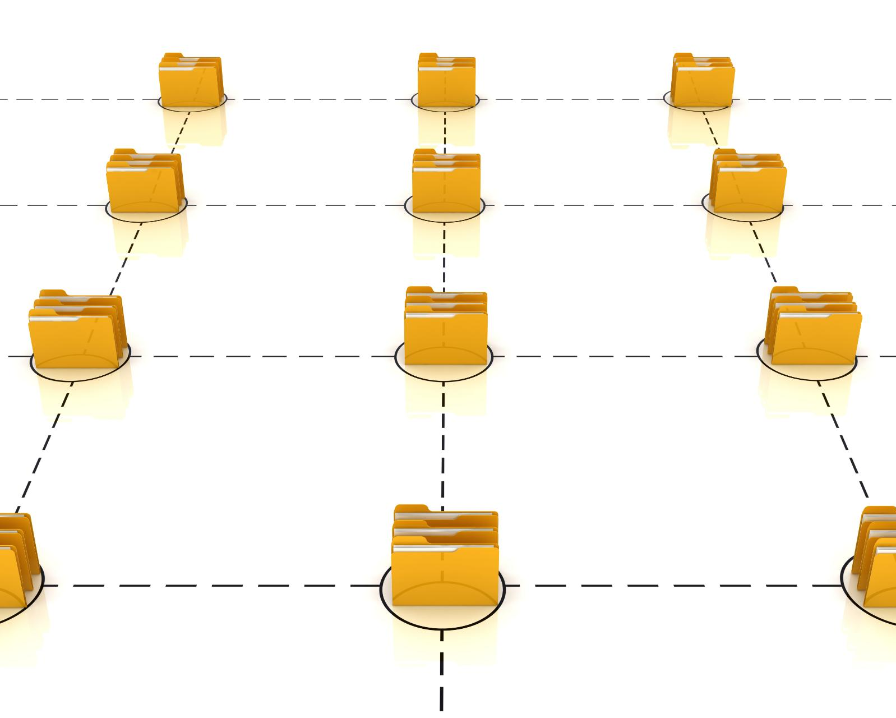
Significance of Hadoop in Big Data Processing
Scalable Framework
Hadoop offers a scalable framework allowing organizations to expand their data processing capabilities as needed, adapting to growing data volumes.
Distributed Processing
Hadoop's distributed processing enables the efficient handling of large datasets across multiple nodes, enhancing performance and reliability.
Versatile Data Handling
Hadoop's ability to process various data types, including structured and unstructured data, makes it crucial for modern data analytics.
Notes:
Hadoop provides a scalable, distributed framework that allows organizations to process large datasets efficiently. Its ability to handle various data types makes it invaluable in the era of Big Data.

Slide 7
Basics of MapReduce
Notes:
MapReduce is a programming model designed for processing large datasets with a parallel, distributed algorithm. Understanding its components is crucial for effective data processing in Hadoop.

Slide 8
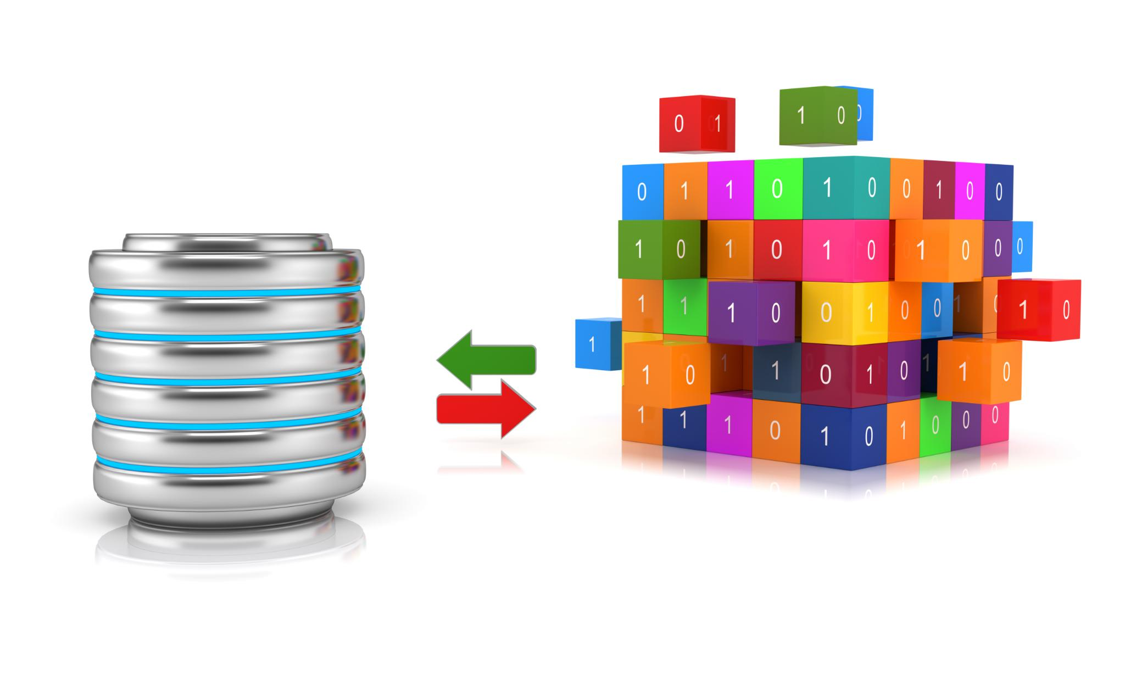
Concept and Origin of MapReduce
Introduction of MapReduce
MapReduce was developed by Google to handle large data processing tasks efficiently in a distributed computing environment.
Core Feature of Hadoop
MapReduce has become an essential part of the Hadoop framework, which allows for scalable and efficient data processing applications.
Notes:
MapReduce was introduced by Google as a way to process vast amounts of data in a distributed environment. It has since become a core feature of the Hadoop framework, enabling efficient data processing.

Slide 9

How MapReduce Works: The Map and Reduce Phases
Map Phase
The Map phase processes input data to produce key-value pairs that summarize the data's essential information.
Reduce Phase
The Reduce phase aggregates the key-value pairs generated in the Map phase to produce the final output.
Notes:
MapReduce consists of two main phases: the Map phase, which processes input data and generates key-value pairs, and the Reduce phase, which aggregates and processes these pairs to produce final output.

Slide 10
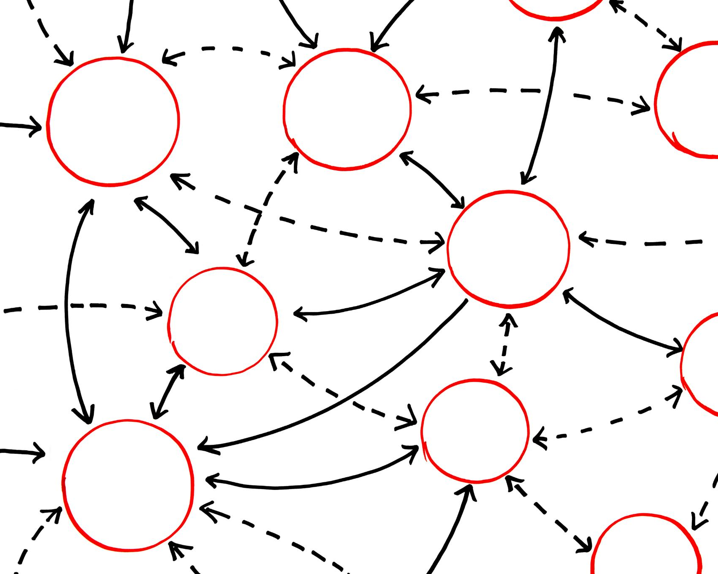
Advantages of Using MapReduce for Data Processing
Scalability
MapReduce can effortlessly scale to handle increasing amounts of data by adding more resources.
Fault Tolerance
The framework is designed to handle failures gracefully, ensuring data processing continues without interruption.
Speed in Processing
MapReduce processes large datasets quickly, making it ideal for time-sensitive Big Data applications.
Notes:
MapReduce offers numerous advantages, including scalability, fault tolerance, and the ability to process large datasets quickly. These benefits make it a preferred choice for Big Data applications.

Slide 11
MapReduce Architecture in Hadoop
Notes:
Understanding the architecture of MapReduce is essential for effectively designing and implementing data processing jobs in Hadoop. It involves key components that manage job execution.

Slide 12

Components of MapReduce: JobTracker, TaskTracker
Role of JobTracker
The JobTracker coordinates all the tasks and jobs in the MapReduce framework, ensuring efficient execution and management of resources.
Function of TaskTrackers
TaskTrackers are responsible for executing individual tasks on nodes, reporting progress and handling task failures for reliable processing.
Distributed Data Processing
The distributed nature of MapReduce allows for efficient data processing across multiple nodes, enhancing performance and scalability.
Notes:
The MapReduce architecture includes the JobTracker, which coordinates jobs, and TaskTrackers, which execute tasks on individual nodes. This distributed setup facilitates efficient data processing.

Slide 13

Data Flow in MapReduce: From Input to Output
Input Stage
The data flow begins with input data being read from various sources, ready for processing in the MapReduce framework.
Mapping Phase
In the mapping phase, data is processed by mappers which transform input into a set of key-value pairs for further processing.
Reducing Phase
The reducing phase consolidates the key-value pairs produced by mappers, generating the final output through aggregation and summarization.
Notes:
Data flow in MapReduce involves several steps, starting with input data being read, processed by mappers, and then reduced by reducers to generate the final output. Understanding this flow is key for effective job design.

Slide 14

Handling Tasks and Failures in MapReduce
Fault Tolerance
MapReduce is built with fault tolerance, allowing it to handle task failures effectively and maintain workflow.
Task Reassignment
When a task fails, MapReduce can seamlessly reassign it to another TaskTracker, minimizing disruption.
Smooth Job Execution
The ability to reassign tasks ensures that jobs continue to run smoothly, enhancing overall system reliability.
Notes:
MapReduce is designed with fault tolerance in mind. If a task fails, MapReduce can automatically reassign it to another TaskTracker, ensuring that jobs continue to run smoothly.

Slide 15
Implementing MapReduce Programs
Notes:
When implementing MapReduce programs, there are specific methodologies to follow that involve writing mappers and reducers. This section will provide a foundational understanding of program structure.

Slide 16

Writing a Basic MapReduce Program: The Mapper and Reducer
Role of the Mapper
The Mapper processes input data, transforming it into key-value pairs for further processing in the MapReduce framework.
Role of the Reducer
The Reducer aggregates the output from the Mapper, combining the key-value pairs into a final result, essential for data analysis.
Understanding Components
Grasping the roles of the Mapper and Reducer is crucial for effectively writing and optimizing MapReduce programs.
Notes:
A basic MapReduce program consists of a Mapper that processes input data and a Reducer that aggregates the output. Understanding the roles of these components is essential for effective programming.

Slide 17
Examples of Common MapReduce Jobs
Word Count Job
The word count job is a classic example that counts the occurrences of each word in a dataset, showcasing MapReduce's efficiency.
Log Analysis
Log analysis is another common MapReduce job that processes server logs to extract useful information and patterns from them.
Data Sorting
Data sorting is a key operation that arranges data in a specified order, which is essential for various data processing tasks.
Notes:
Common MapReduce jobs include word count, log analysis, and data sorting. Each example illustrates how MapReduce can simplify complex data processing tasks.

Slide 18
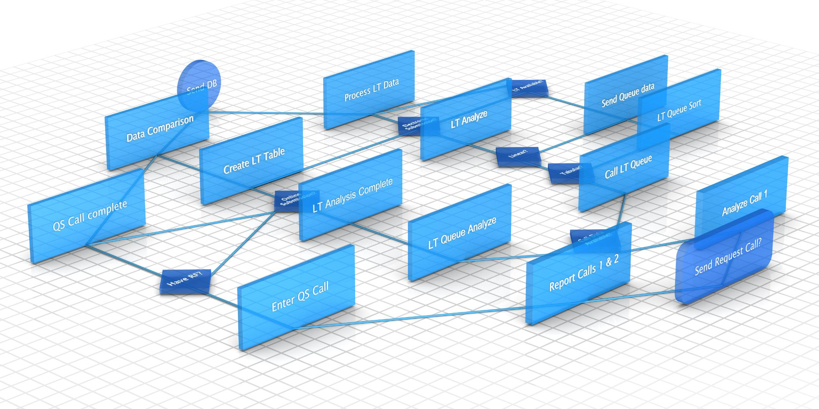
Optimization Techniques for Efficient MapReduce Jobs
Data Locality
Optimizing data locality ensures that the data is processed where it is stored, reducing latency and improving performance.
Combiners
Using combiners helps to reduce the amount of data transferred between the map and reduce phases, thus enhancing job efficiency.
Tuning Configuration
Tuning configurations such as memory allocation and parallelism settings can significantly improve resource management during MapReduce jobs.
Notes:
To enhance the performance of MapReduce jobs, various optimization techniques can be employed, such as data locality, combiners, and tuning configurations for better resource management.

Slide 19
MapReduce Use Cases and Applications
Notes:
MapReduce finds applications across various industries, from finance to healthcare. This section will explore its diverse use cases and the benefits it brings to organizations.

Slide 20


Use Cases in Different Industries
E-commerce Data Analysis
E-commerce companies leverage MapReduce for analyzing customer data and optimizing product recommendations, enhancing the shopping experience.
Social Media Insights
Social media platforms use MapReduce to analyze user interactions and trends, providing valuable insights to improve engagement strategies.
Telecommunications Efficiency
Telecommunications companies utilize MapReduce for operational efficiency, enhancing network performance and customer service through data analysis.
Notes:
Industries such as e-commerce, social media, and telecommunications utilize MapReduce for data analysis, customer insights, and operational efficiency. Each use case showcases the versatility of the framework.

Slide 21

Comparing MapReduce with Other Data Processing Models
Simplicity of MapReduce
MapReduce is known for its straightforward programming model, making it easier to implement data processing tasks.
Scalability of MapReduce
One of the key advantages of MapReduce is its ability to scale efficiently with large datasets across distributed systems.
Comparison with Spark and Flink
Understanding the differences between MapReduce, Spark, and Flink helps in selecting the most suitable model for specific use cases.
Notes:
MapReduce stands out among data processing models like Spark and Flink due to its simplicity and scalability. This comparison helps to highlight when to use each model effectively.

Slide 22

Future Trends in MapReduce and Hadoop Ecosystem
Cloud Integration
The integration of cloud technologies with MapReduce is expected to enhance scalability and accessibility in data processing.
Machine Learning Trends
Machine learning will play a crucial role in improving data analysis and decision-making within the Hadoop ecosystem.
Real-Time Processing
The demand for real-time data processing is growing, leading to advancements in streaming technologies within the Hadoop ecosystem.
Notes:
As technology evolves, MapReduce and the Hadoop ecosystem will continue to adapt. Trends such as cloud integration, machine learning, and real-time processing are set to shape the future of data processing.

Slide 23
Conclusion
Importance of MapReduce
MapReduce revolutionizes the processing of large datasets, making it an essential tool for data analysis.
Understanding Architecture
Grasping the architecture of MapReduce is crucial to effectively using the Hadoop ecosystem for big data.
Applications of MapReduce
MapReduce has numerous applications in big data analytics, enhancing how organizations process information.
Notes:
In conclusion, MapReduce is a vital component of the Hadoop ecosystem, revolutionizing how we process large datasets. Understanding its architecture, implementation, and applications is key to leveraging its full potential.

